Slide 1
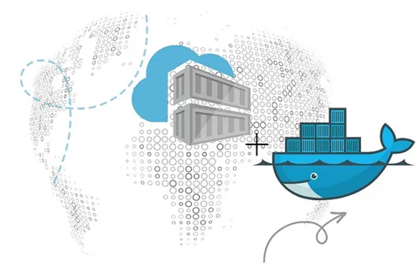
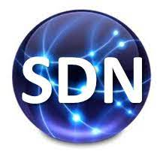
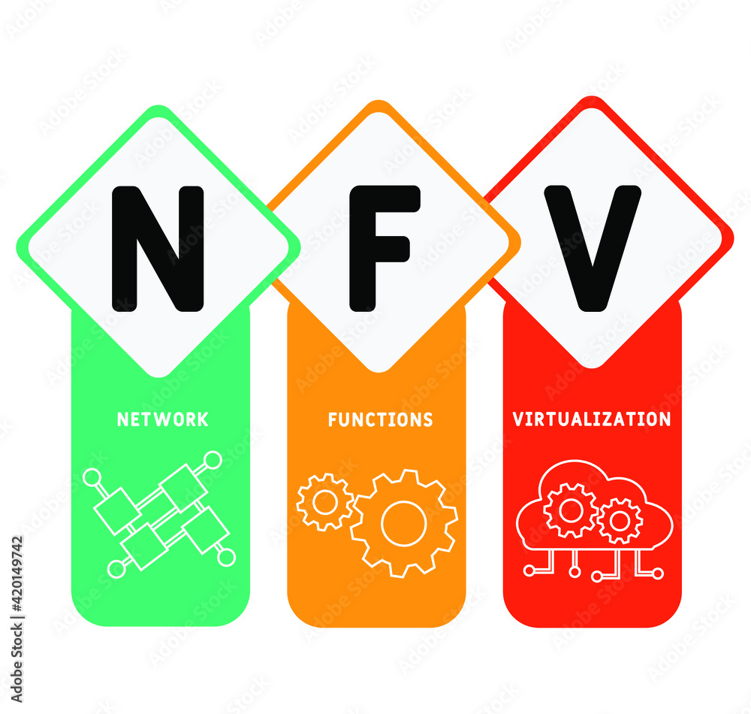
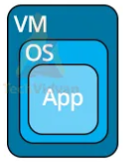
PDS
Computer Vision
Deploying Deep Learning Models on Kubernetes with GPU
.
https://github.com/siagianp
https://www.youtube.com/@AmelOline/videos
https://github.com/amelcharolinesgn2/IoT_simulator-mqtt-NodeRed
https://github.com/amelcharolinesgn2/Cloud-Infrastructures
https://github.com/amelcharolinesgn2/ClouD-Infrastructure-SISKA-2025
Notes:
https://roadmap.sh/aws
https://roadmap.sh/aws
https://aws.amazon.com/what-is-cloud-computing/
https://www.ibm.com/think/topics/cloud-computing
3. https://www.ibm.com/topics/cloud-computing
4. https://csrc.nist.gov/pubs/sp/800/145/final
https://csrc.nist.gov/pubs/sp/800/145/final
https://docs.openstack.org/liberty/install-guide-rdo/overview.html

Slide 2
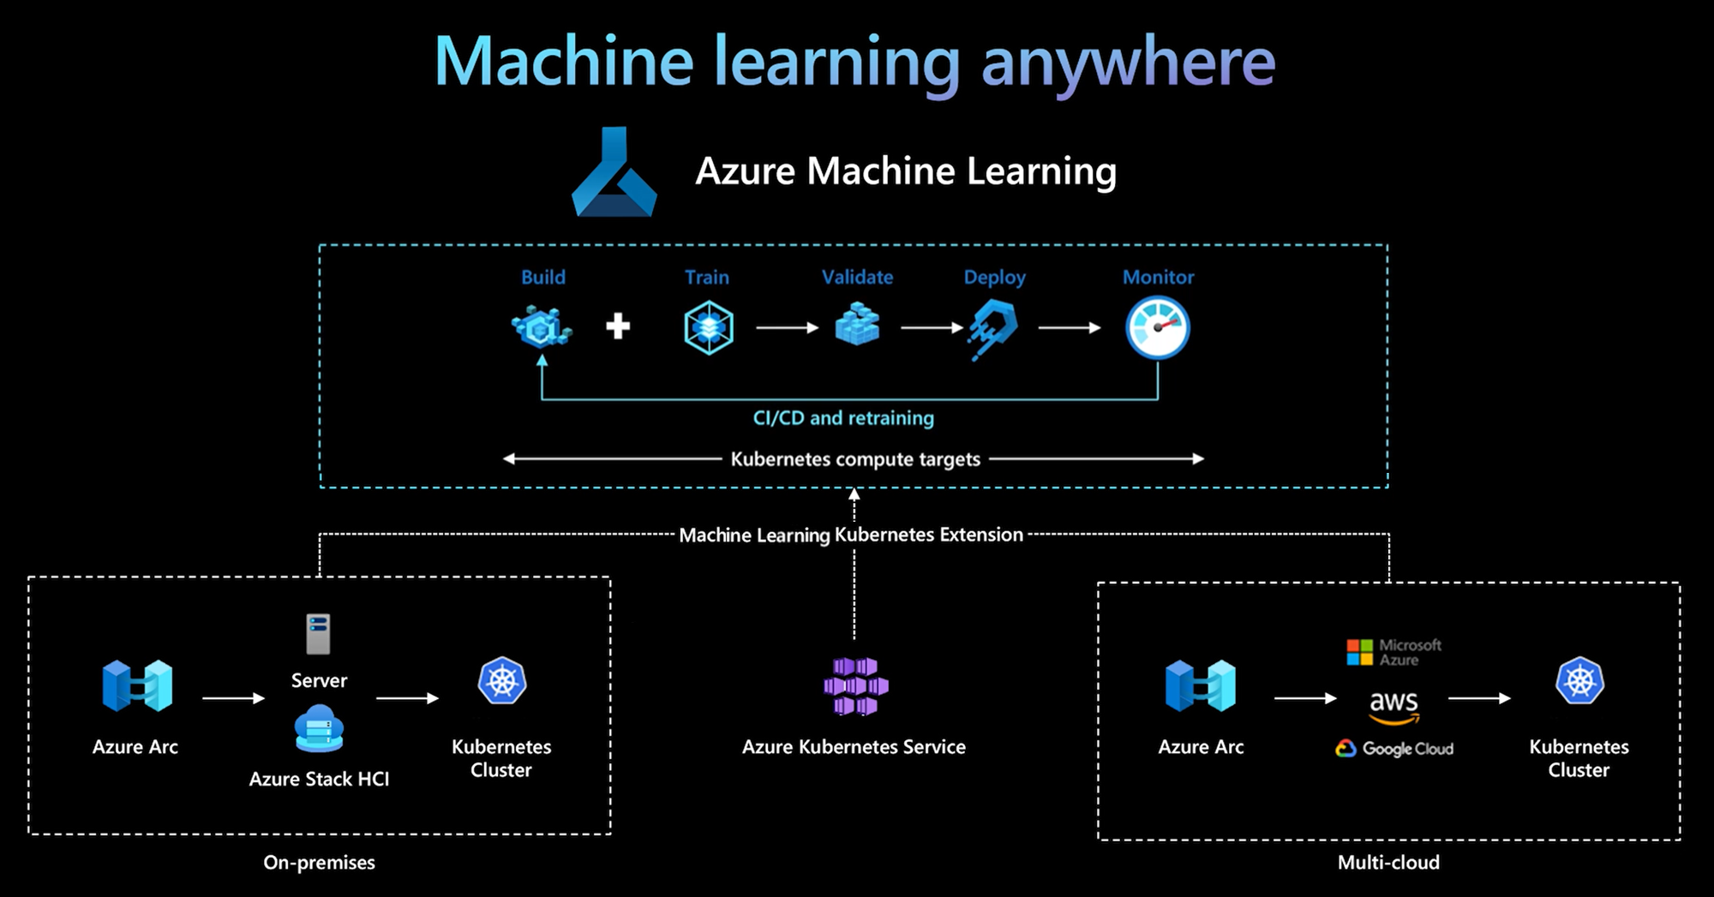

Slide 3
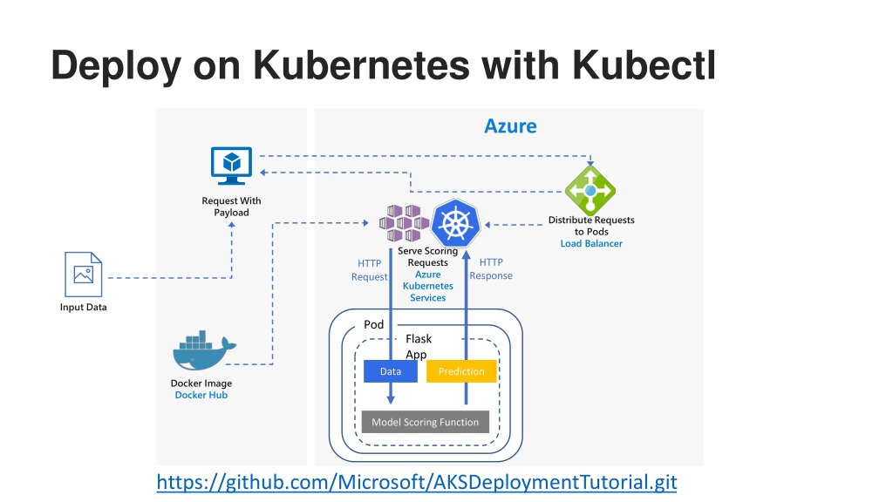
Deploying Deep Learning Models on Kubernetes with GPU

Slide 4
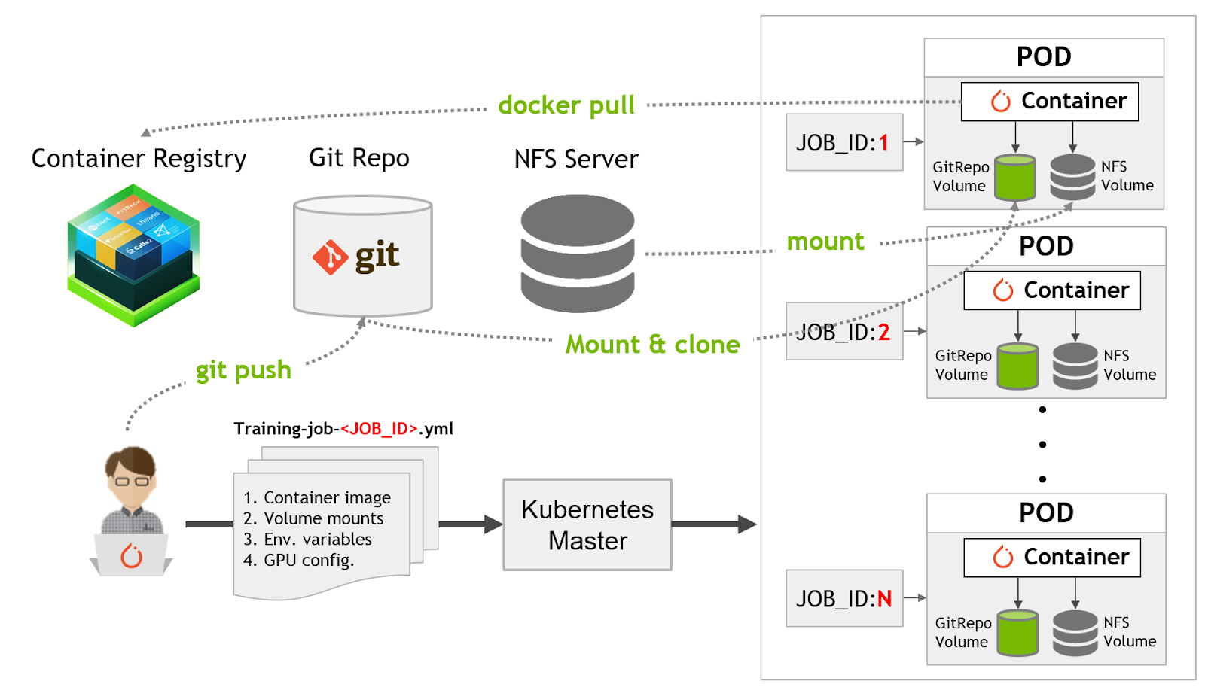
Kubernetes For AI Hyperparameter Search Experiments |

Slide 5
Github
Automate provisioning in the self-service platform
Notes:
https://conferences.oreilly.com/artificial-intelligence/ai-ny-2019/public/schedule/detail/72321.html
https://s.itho.me/events/2019/k8s/1525-1605%20%E5%BC%B5%E5%AE%B6%E6%A3%A0_AI%20on%20Kubernetes.pdf
https://medium.com/hackernoon/gpus-kubernetes-for-deep-learning-part-1-3-d8eebe0dd6fe
https://github.com/alibaba/GPU-scheduler-for-deep-learning

